Slide 1
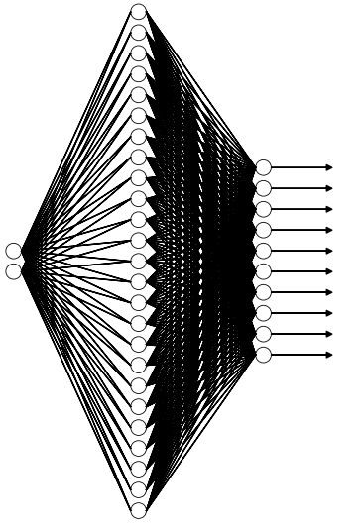
Benchmarking Neural Network Platforms
Base Network Architecture:
Loss Function = Cross Entropy
Optimizer = Gradient Descent
Learning Rate = 0.01
Hidden: 25, Relu Activation
Platforms Tested:
TensorFlow
PyTorch
CNTK
Training Dataset:
Subset of MNIST handwriting recognition dataset.
5000 handwritten numbers 0 to 9.
20x20 Images (400 Flattened Pixels)
Out: 10, Relu Activation
Input:
400 Pixel Values
Softmax
Notes:
So im going to be giving a quick talk on a couple of projects we have been working on over the past 2/3 weeks.
Our first project was test out and benchmark a number of machine learning neural network platforms.
In particular focusing on TensorFlow, PyTorch and CNTK.
The data set we used was a subset of the well know mnist handwriting dataset.
Specifically we were looking at 5000 20x20 images of the numbers 0 to 9.
The basis of the network we were using to test this consisted of an input of all 400 pixels for each image, a single hidden layer of 25 neurons and the Relu activation function and 10 output neurons that each represent the probability that the image is a zero one two three and so on. The final component is the inclusion of a softmax layer that turns an array of probabilities into a definitive choice of number.
The Loss function used was the cross entropy function and the optimization method used was gradient descent.

Slide 2
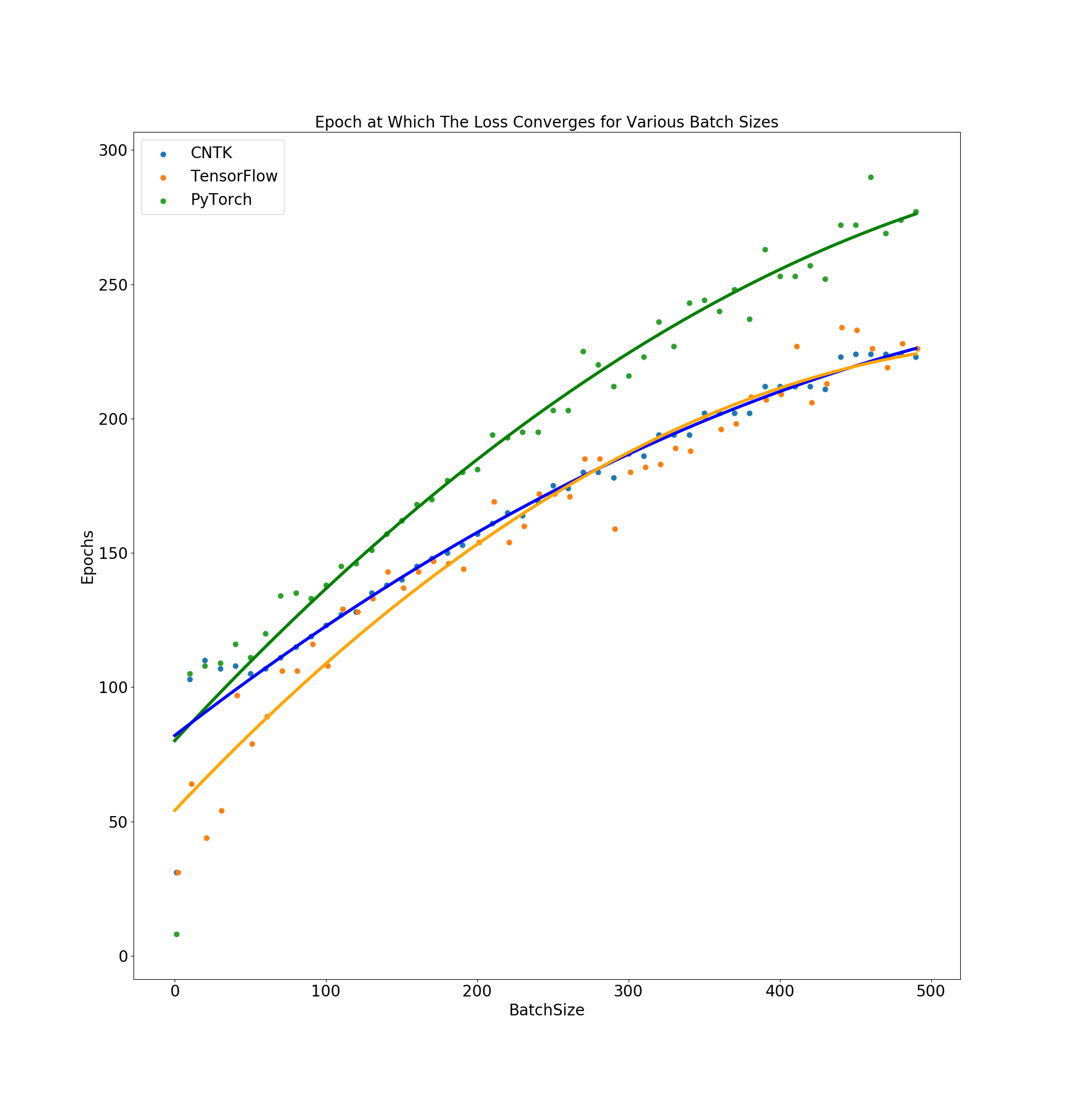
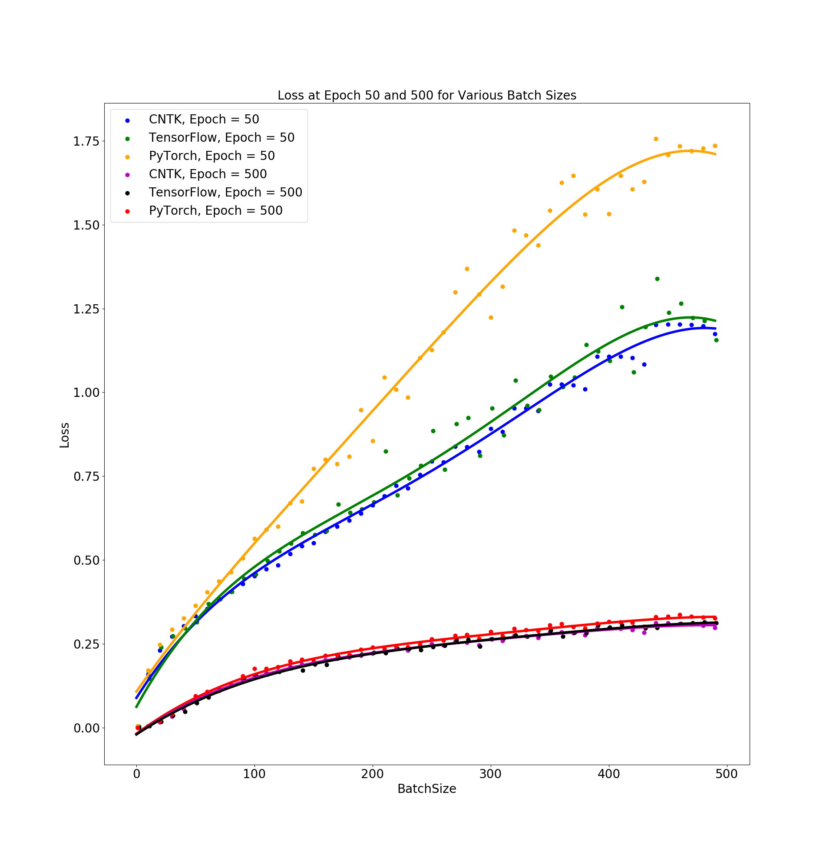
Variable Batch Size
Notes:
So the first test was to see how the different platforms performed for different batch sizes used when training the network.
So the batch size describes how many images are put through the network in parallel where the weights of the network are updated on a batch by batch basis.
The first plot shows the epoch at which the training loss converged. You can see that as the batch size is increased it took more epochs for the training to converge. Here CNTK and Tensorflow performed similarly where as it took pytorch slightly more.
The second plot shows the convergence loss at the 50th and 500th epoch for all the platforms. The lower curves represent the 500th epoch where all platforms ended up at similar loss values. At the 50th epoch CNTK and Tensorflow were at similar values but pytorch had a slightly higher loss at the same point in the training.

Slide 3
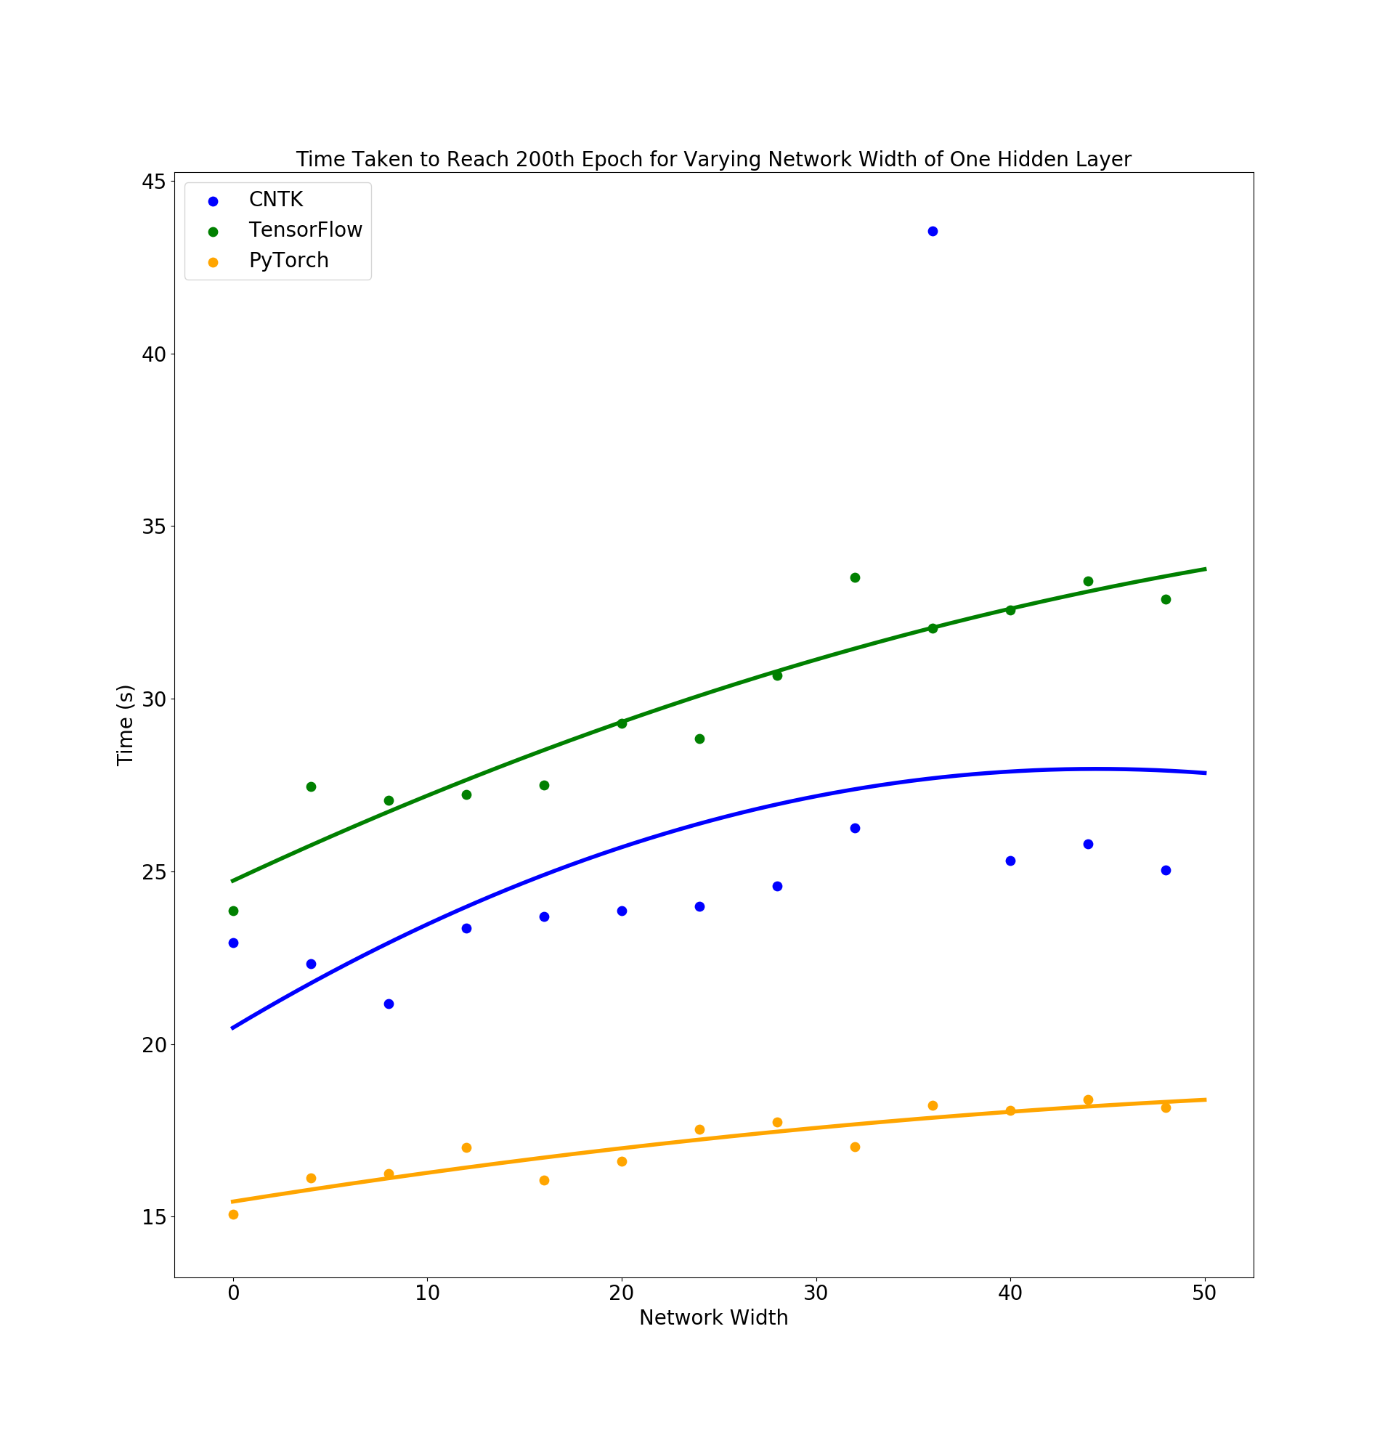
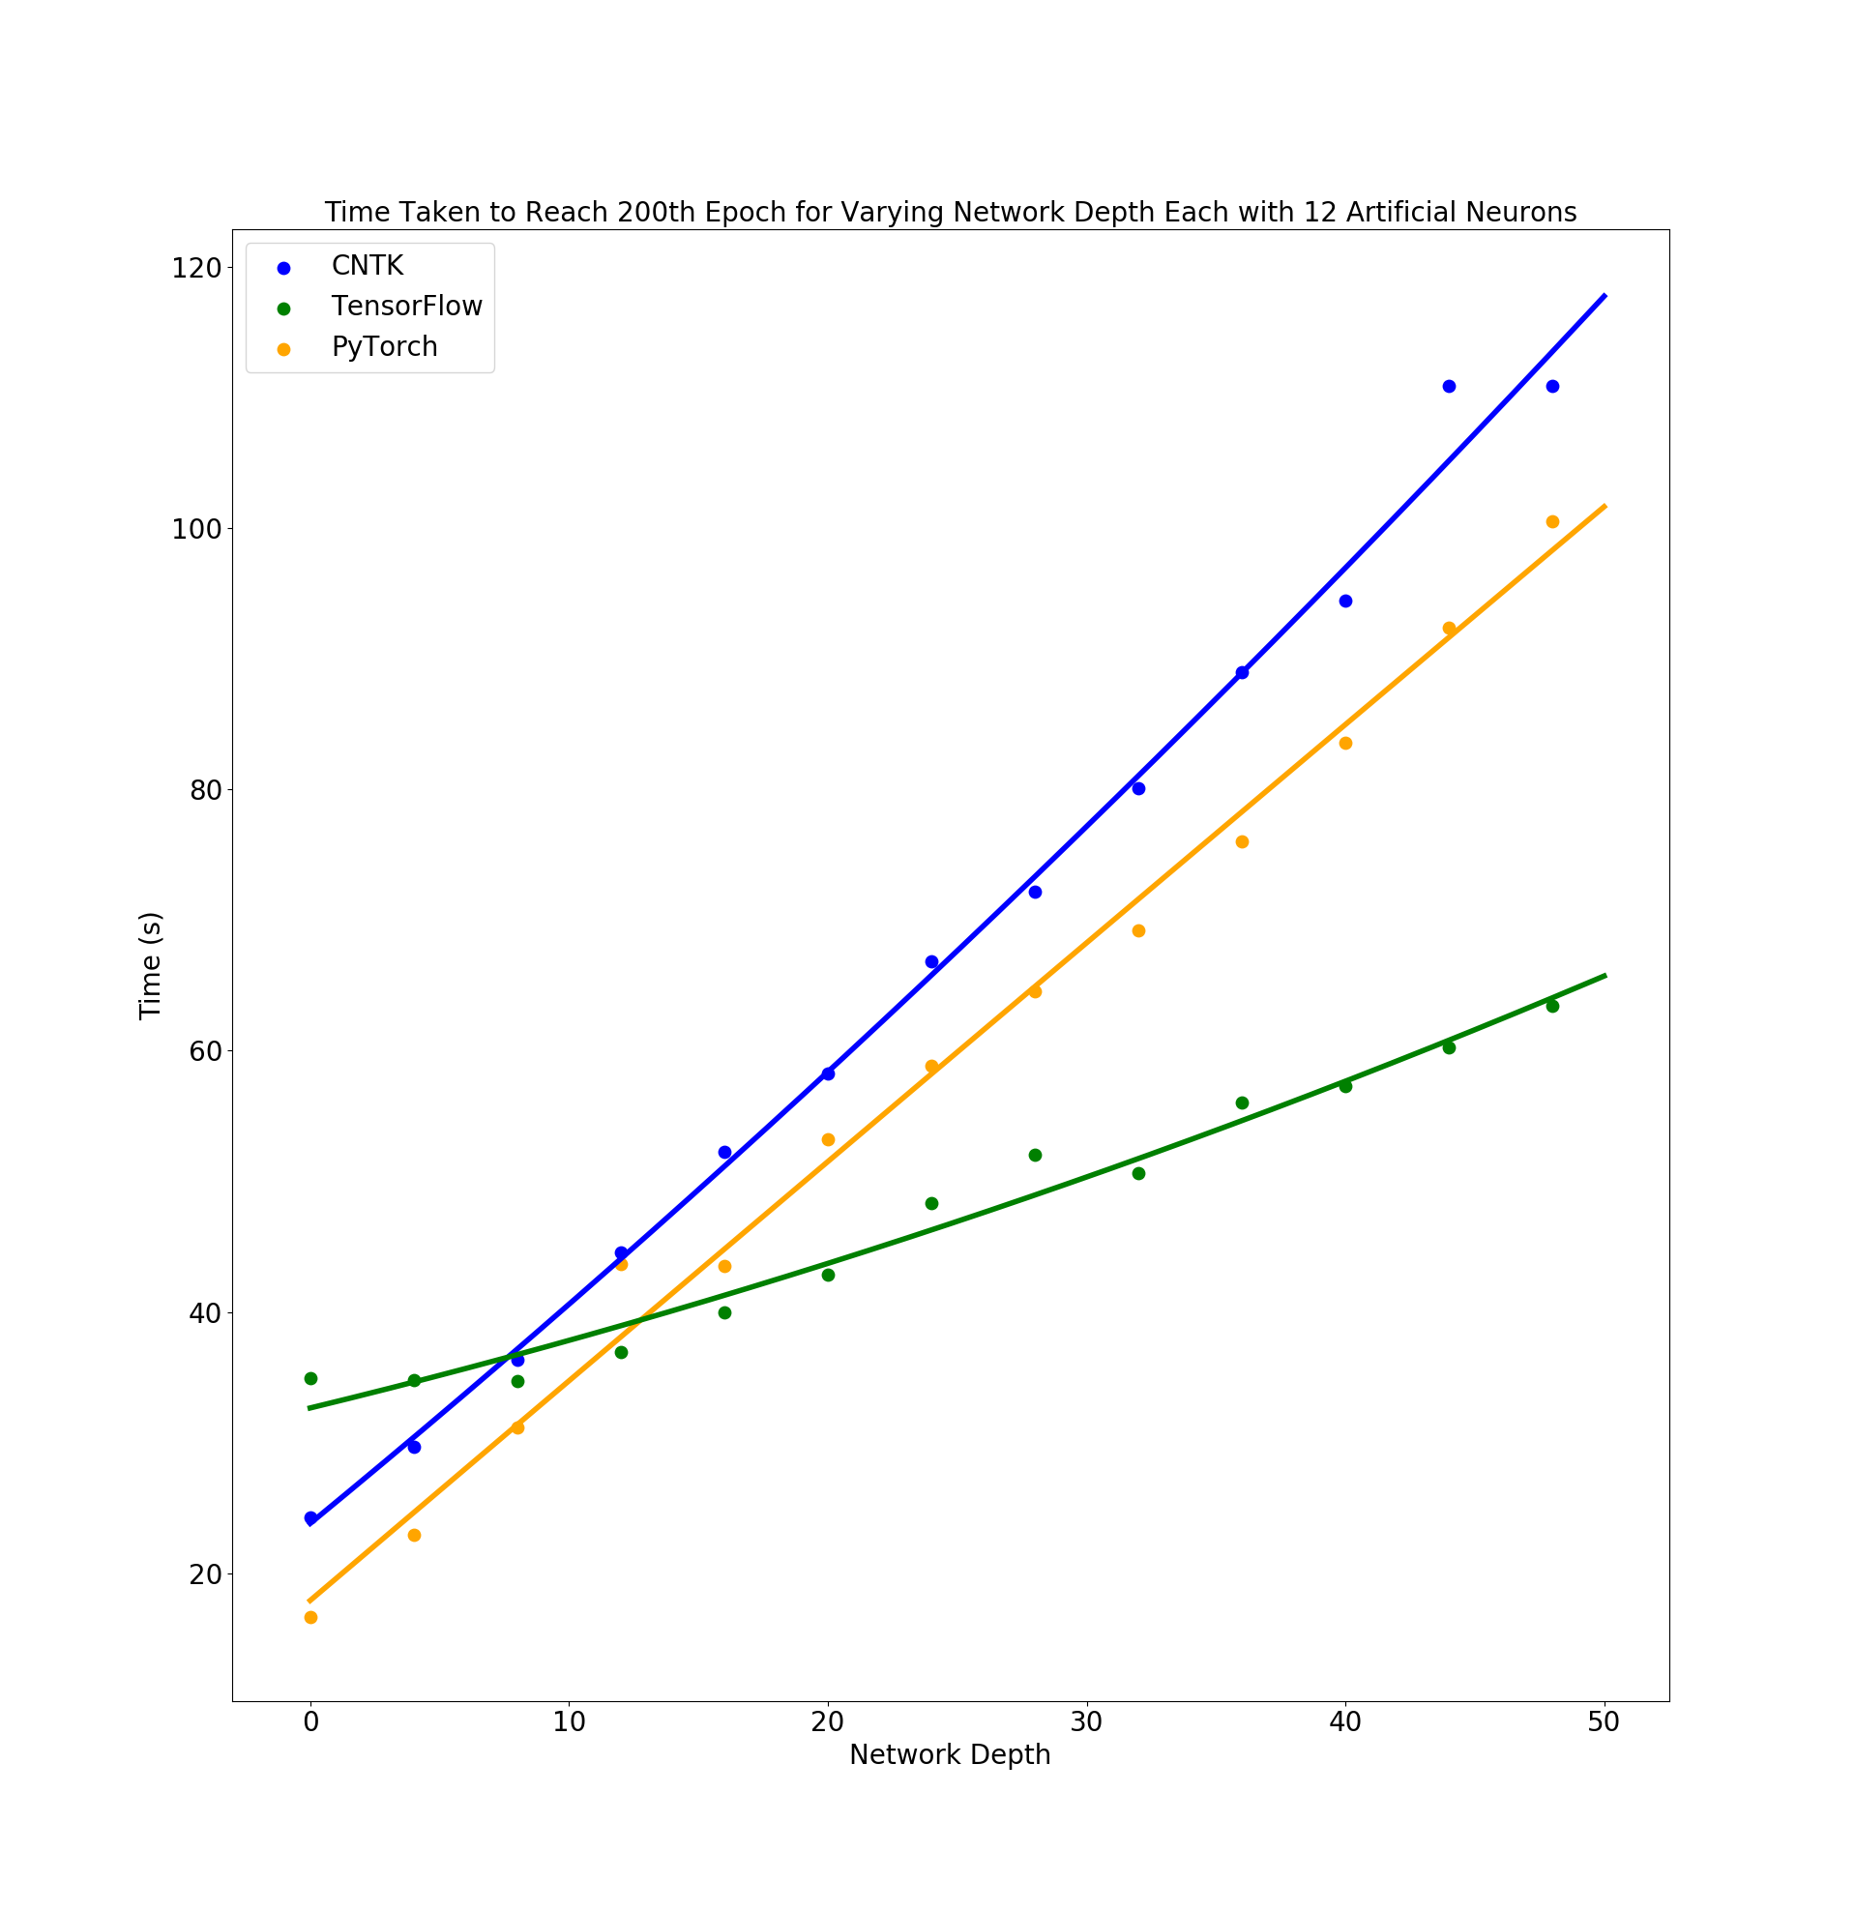
Variable Network Width/Depth Vs Time
Notes:
We then tested how the platforms varied for different network widths and depths.
The first figure describes the time taken for the training to converge as more neurons are added to a single hidden layer and the second figure describes how adding more hidden layers of the same size effects training time. As you can see all the platforms had a similar linear increase in training time with increased depth having a much larger effect on training time.. Interestingly the Pytorch platform was actually the fastest for both tests and Tensorflow being the slowest.

Slide 4
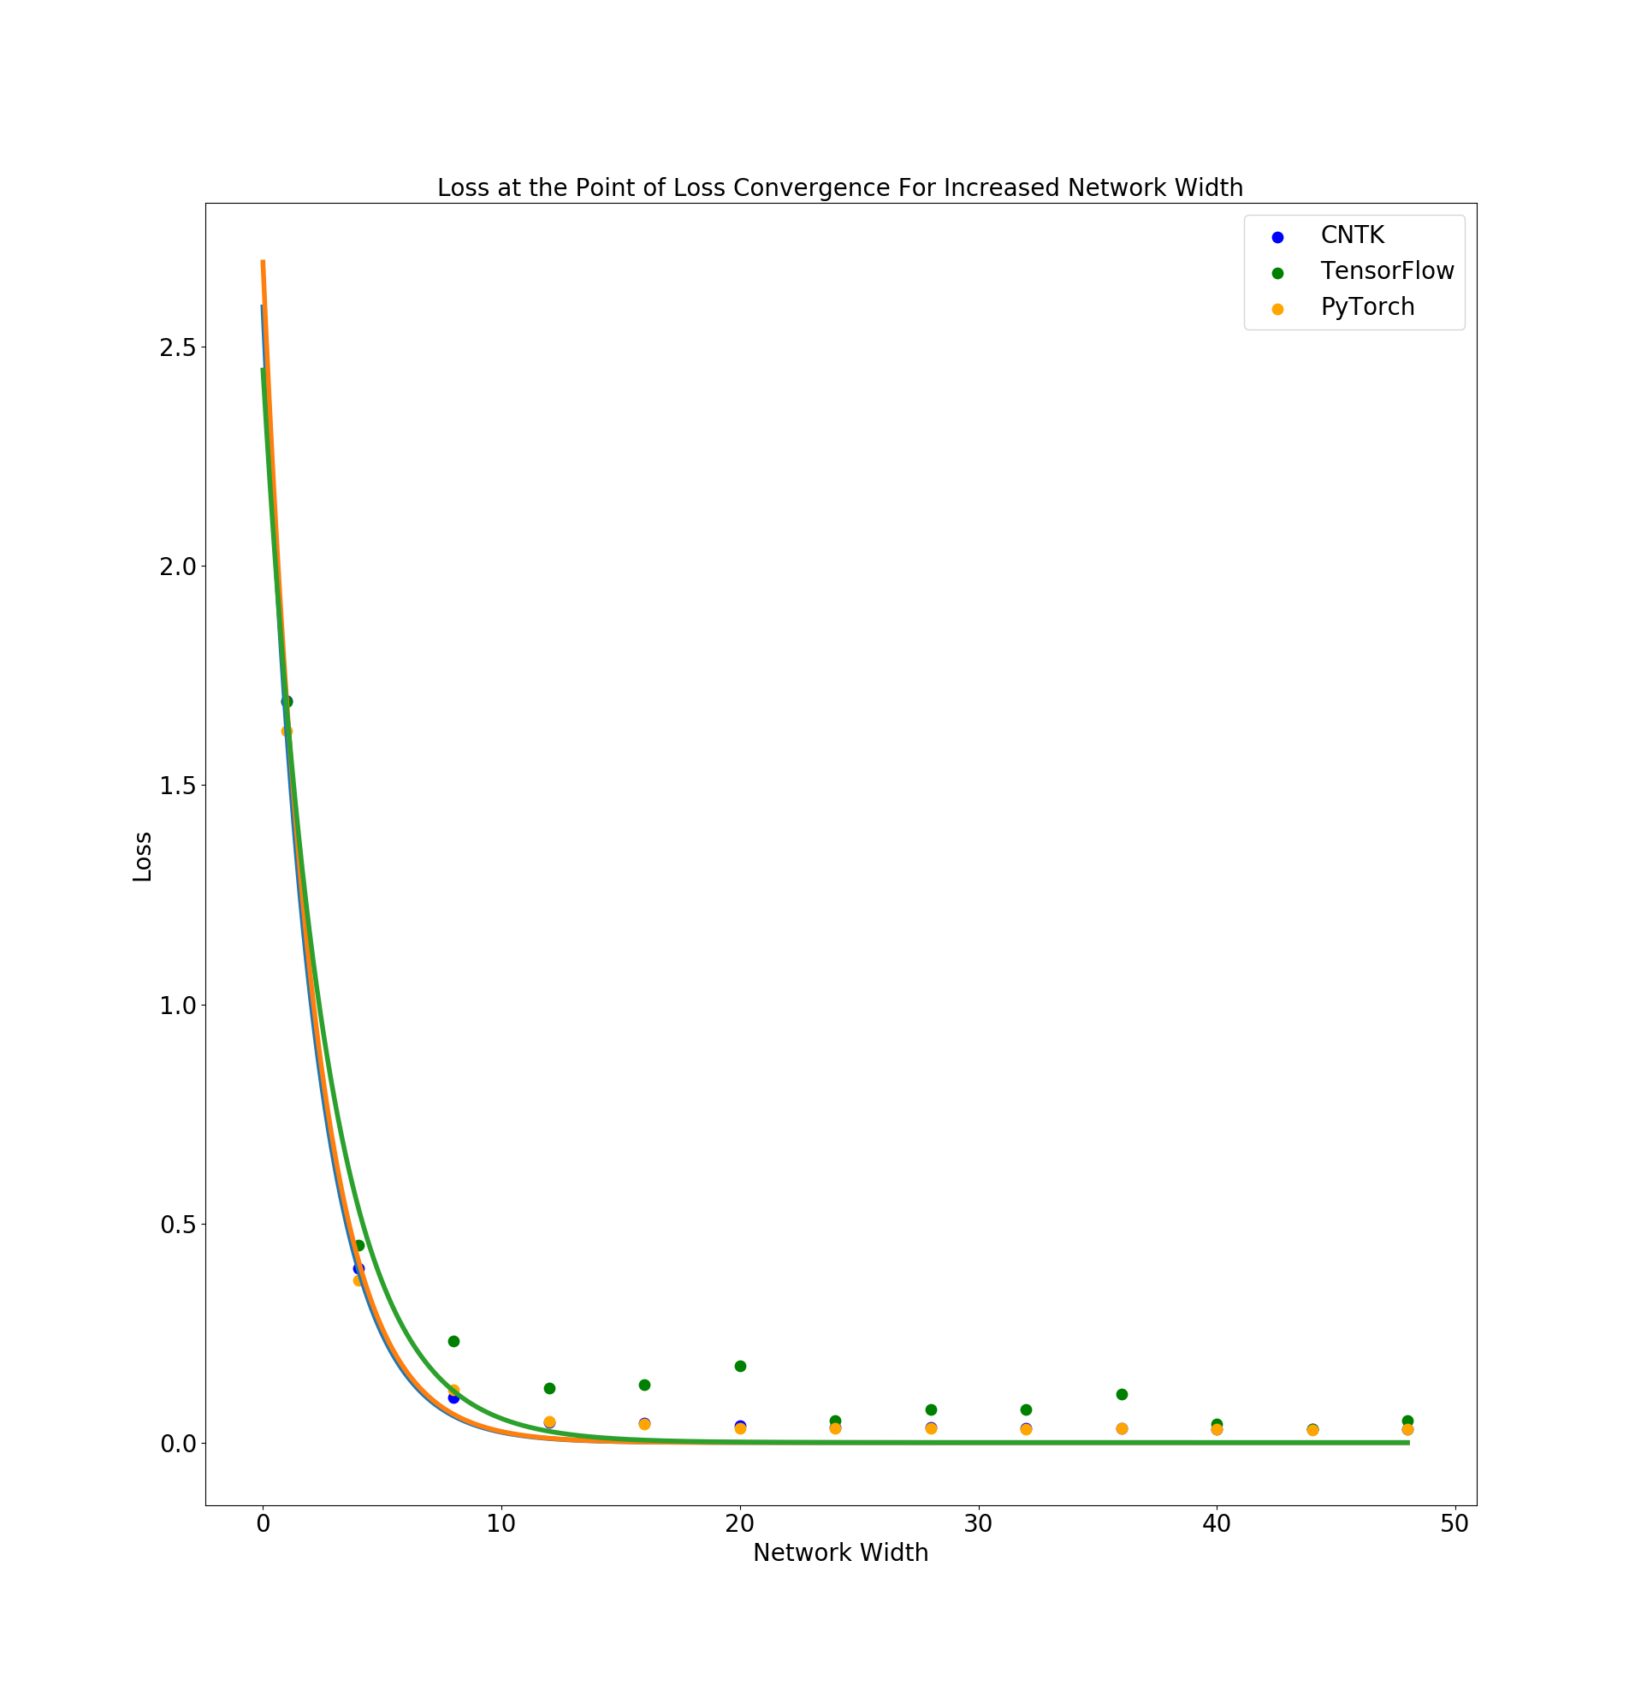
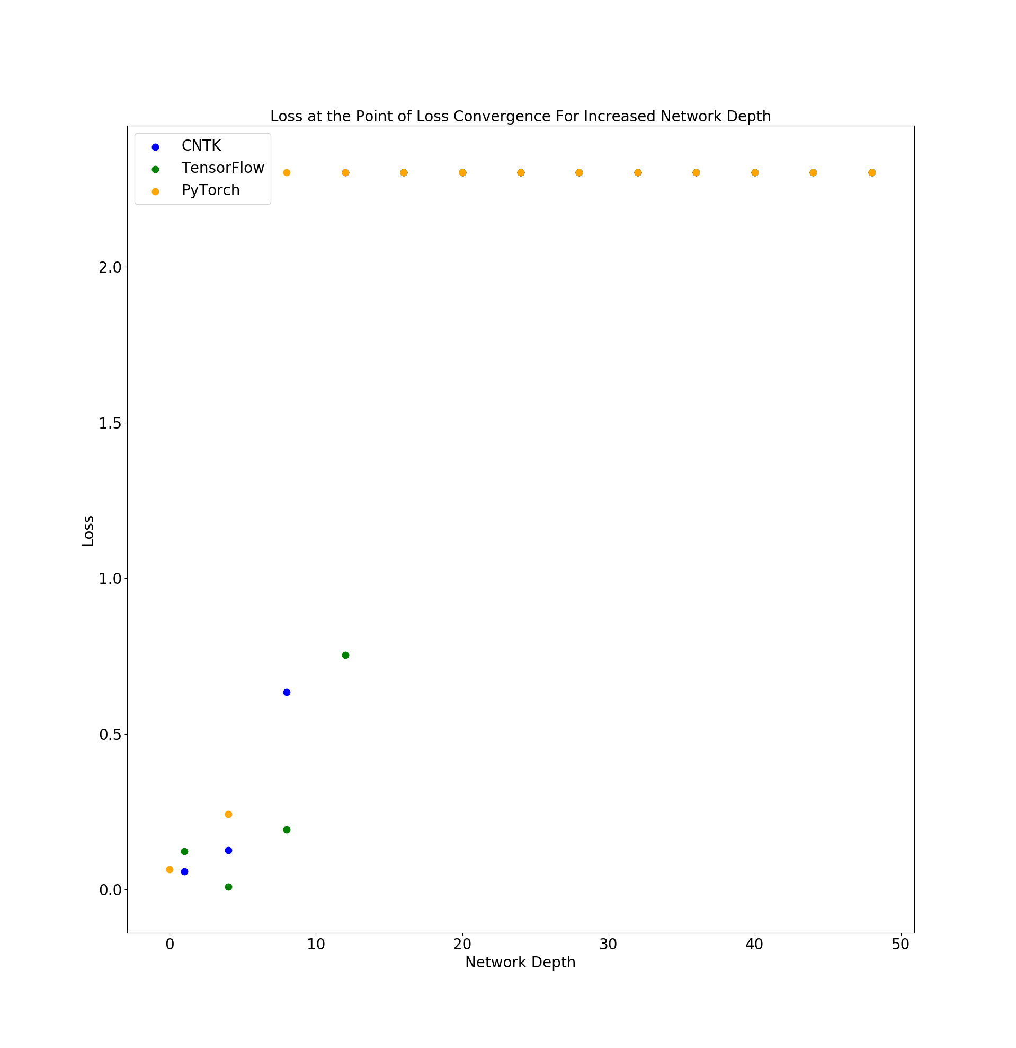
Variable Network Width/Depth Vs Convergence Loss
Notes:
We then looked at how the loss is effected for different network width and depth. All platforms performed similarly here.
We saw that at a certain point adding more neurons to a single hidden layer had very little effect on the convergence loss after a certain width.
For me unexpectedly we found that initially increasing the depth improved the convergence loss but at a certain depth the network would become ineffective at training this result was the same for a variety of batch sizes and learning rates.
I have some guesses at why this might be but nothing concrete.

Slide 5
Classification of RR Layrae Stars
Aim: Compare Traditional Machine Learning To Neural Networks
Classifying between non variable and variable main sequence stars.
Each data point consists of 4 color values in different regions of the light spectrum [ u-g , g-r , r-i , i-z ].
Using TensorFlow.

Slide 6
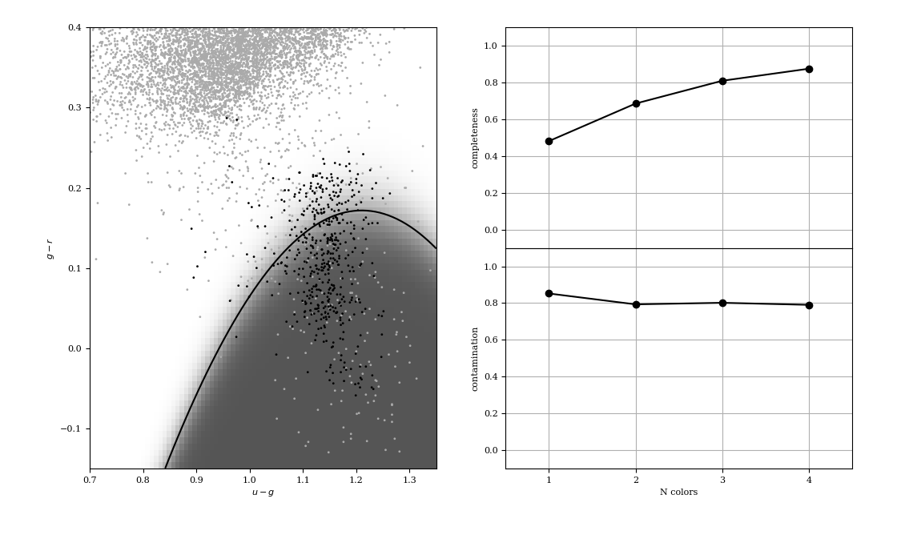
Gaussian Naive Bayes Classification of RR Layrae Stars
of RR Layrae Stars
Data Imbalance: 1:225 ratio of Class 1 (Black) to Class 0 (Grey)
[ u-g , g-r , r-i , i-z ]
Notes:
The second project we have been working on is the classification of astronomical data. Specifically the classification of variable and non variable main sequence stars as part of the RR lyra data set.
The aim of this was to compare neural networks with more traditional machine learning algorithms, specifically the Gaussian naïve bayes algorithm. Here you can see the two classification of stars represented by the black and grey points , and the resulting decision boundary of the classification.
To compare the different algorithms the completeness and contamination are used.
Essentially the completeness describes how many of the black stars are within the black area of the decision boundary.
The Contamination describes how many of the grey stars are with in the black boundary, so we want a high completeness and a low contamination.
Each data point is described by 4 color values, representing different areas of the color spectrum. The traditional classification was trained for different numbers of input colors.

Slide 7
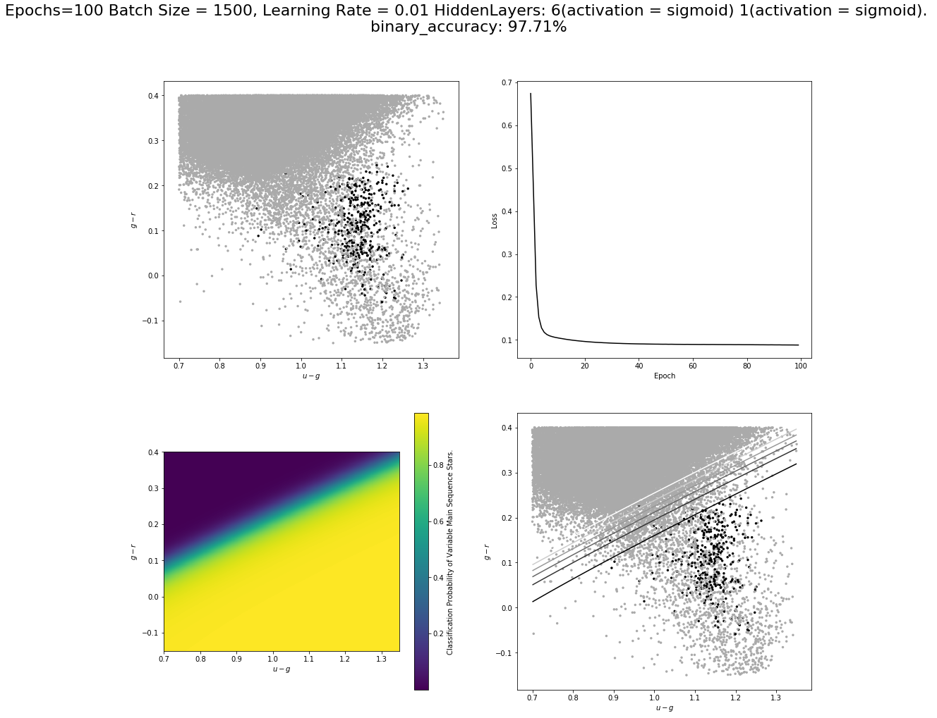
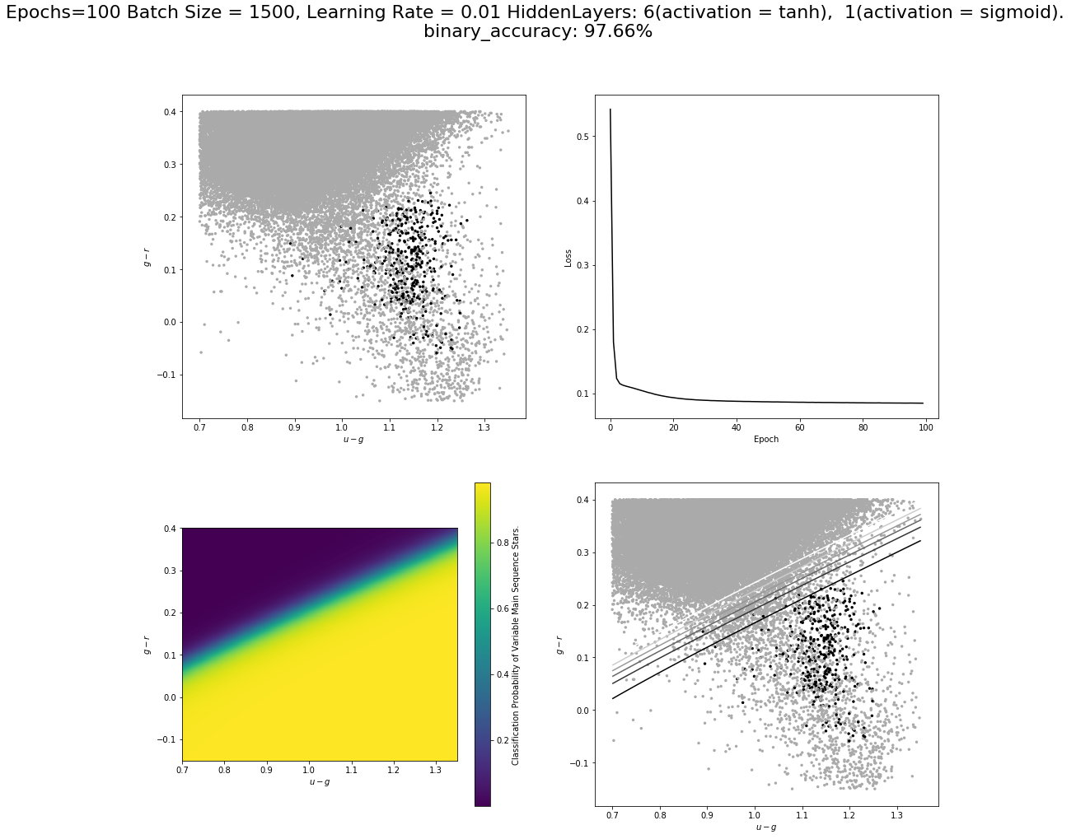
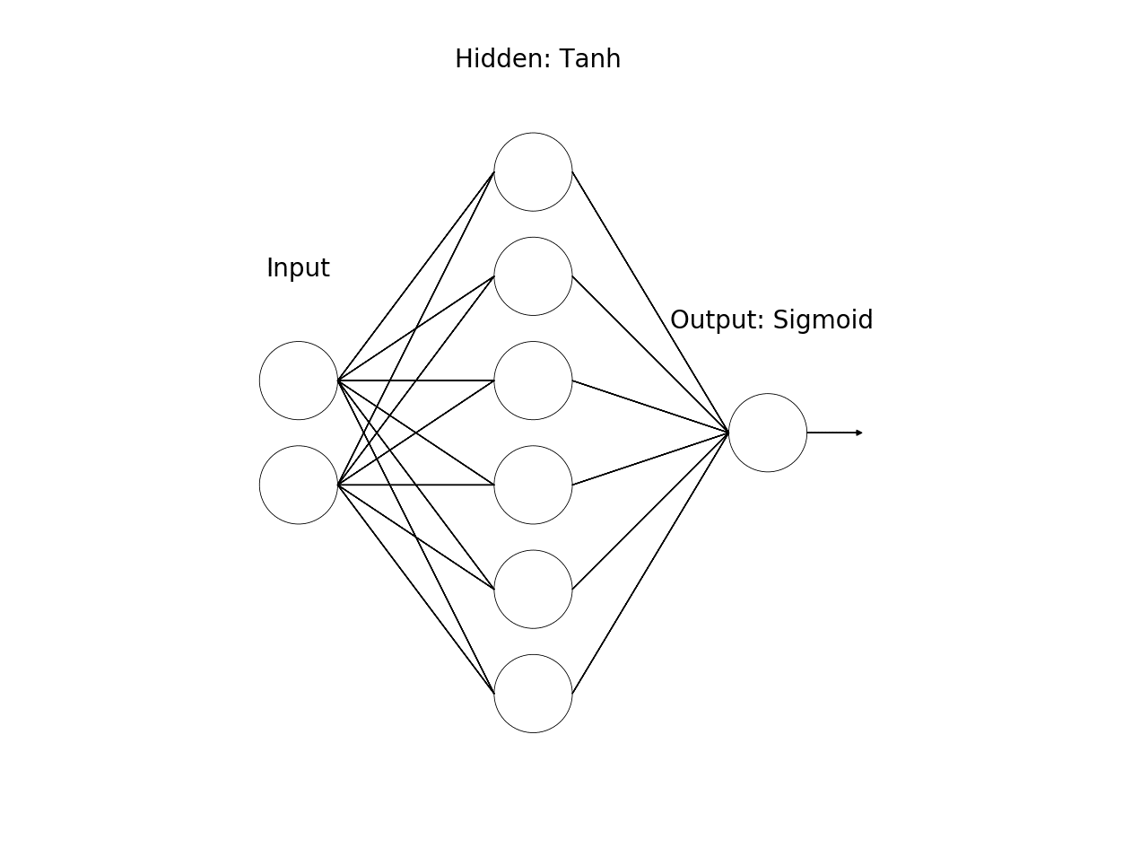
Data Imbalance: 1:225 ratio of Class 1 (Black) to Class 0 (Grey)
Notes:
So when applying neural networks to the data set we had a couple of initial problems. The main being an imbalance in the representation of each class in the data set, specifically there was a 1 :225 ration of the black stars to Grey.
This was solved by artifitally rebalancing the data by adding increased duplicates of the black data until the data set was more balanced.
The first network tested was a simple network where each data point was fed into the network and then a classification of 0 or 1 was output.
We started with a single hidden layer of 6 neurons that resulted in a linear decision boundary.
We then tried various different network designs.

Slide 8
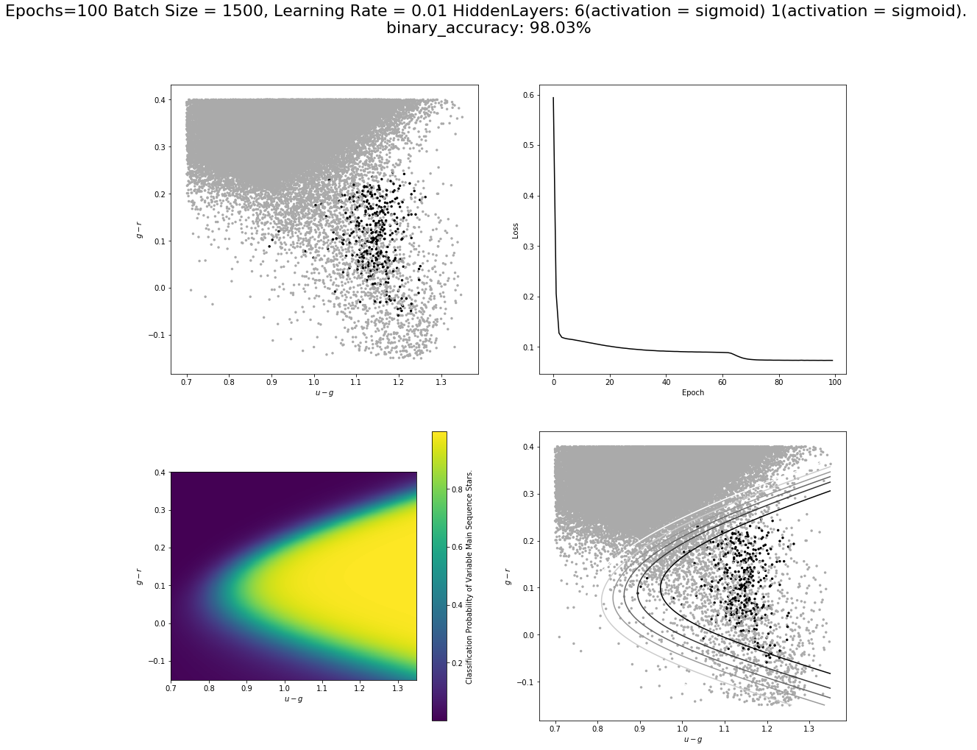
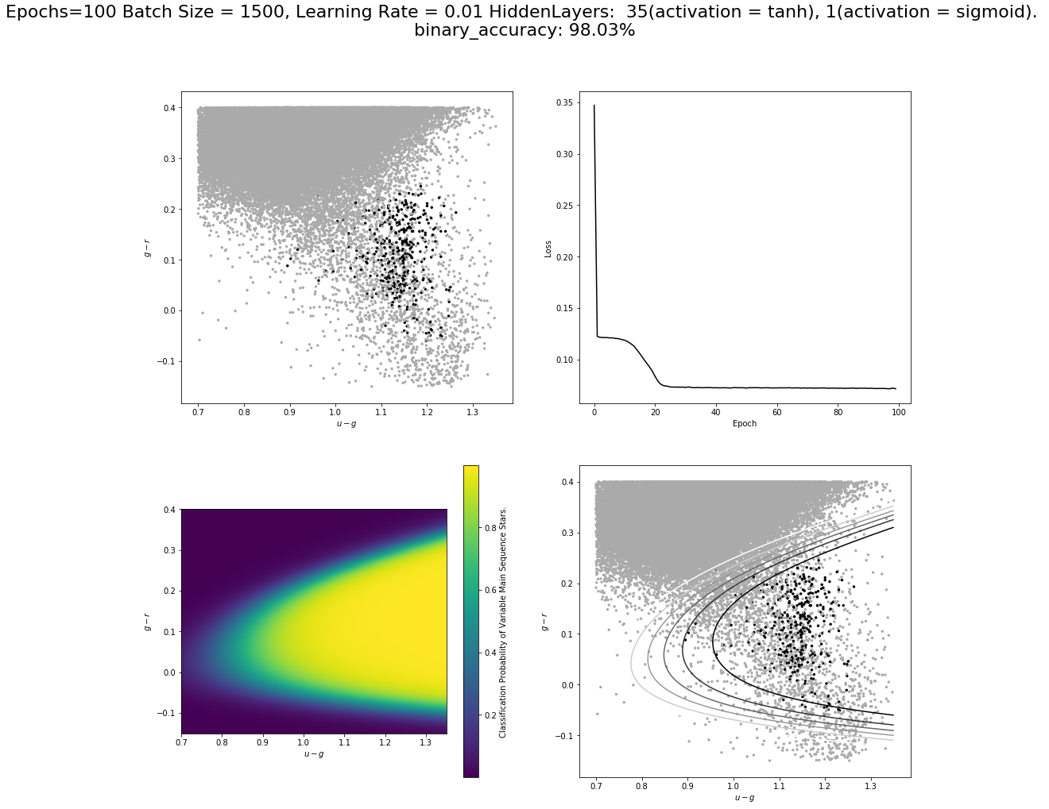
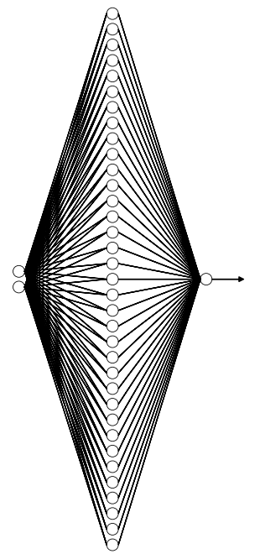
Hidden: 35, tanh
Input: 2,3,4
Out: 1, Sigmoid
Notes:
Such as increasing the number of neurons in the hidden layer, and adding more layers until we settled on the following design.

Slide 9
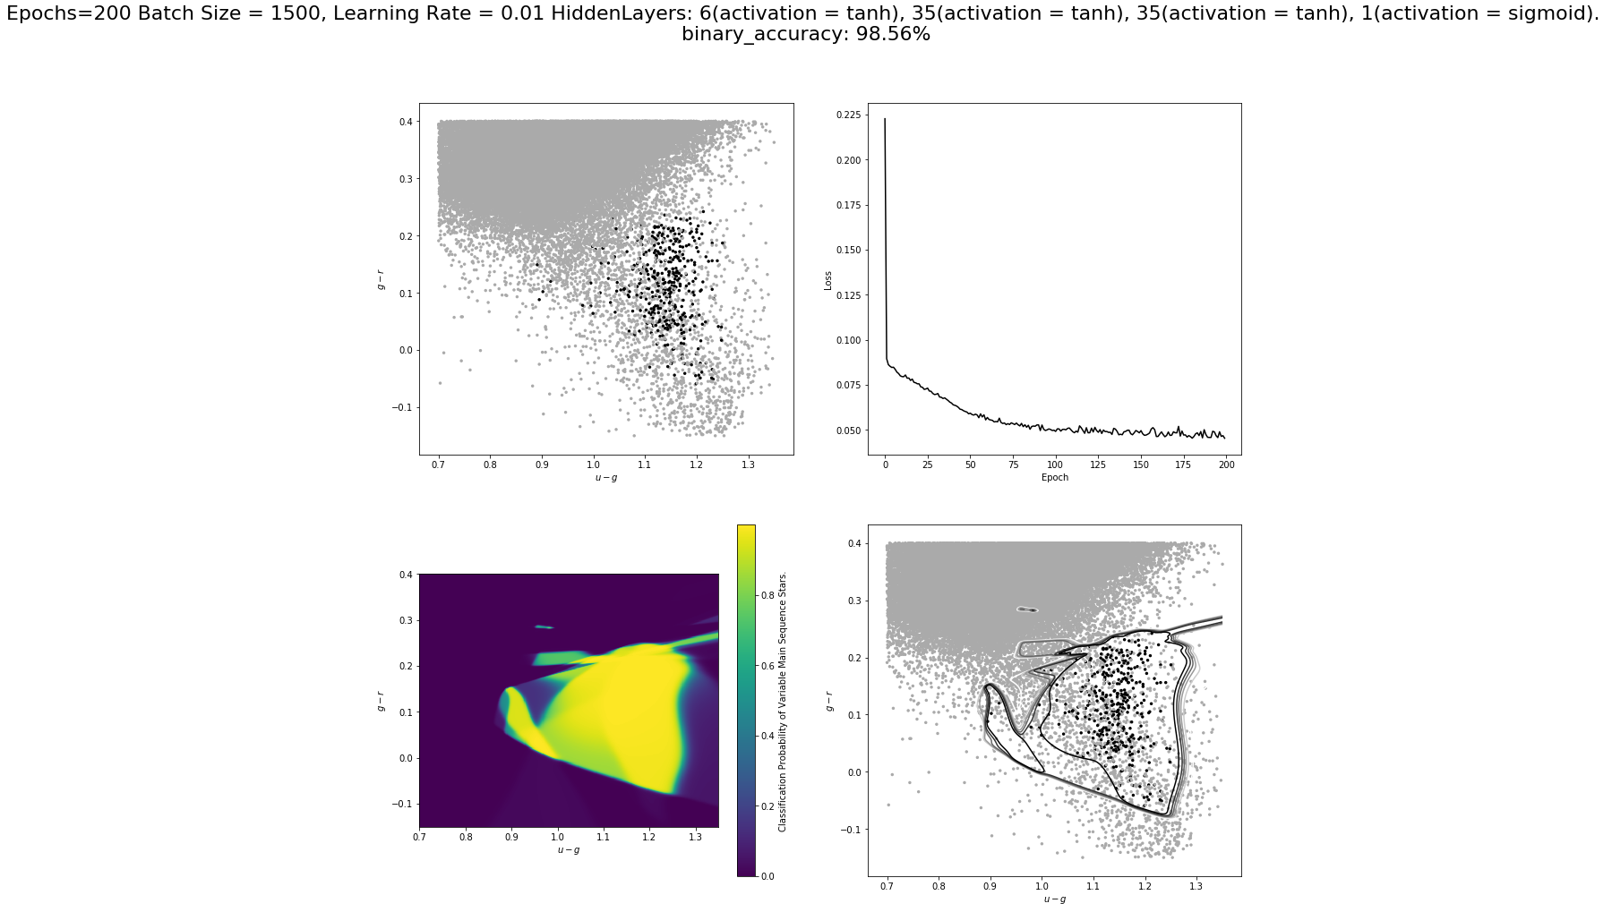
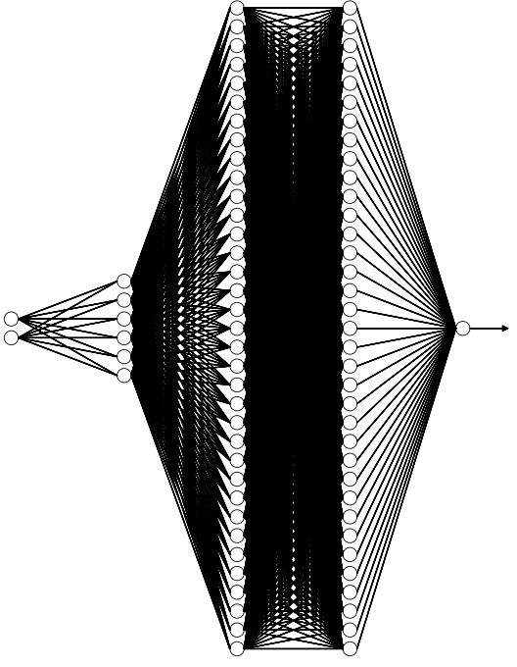
Hidden: 35 x 2, tanh
Hidden: 6, tanh
Out:
1, Sigmoid
Input: 2,3,4
Notes:
The consists of three hidden layers, one of 6 neurons and 2 of 35. This produced a better decision boundary but looked somewhat overfit.

Slide 10
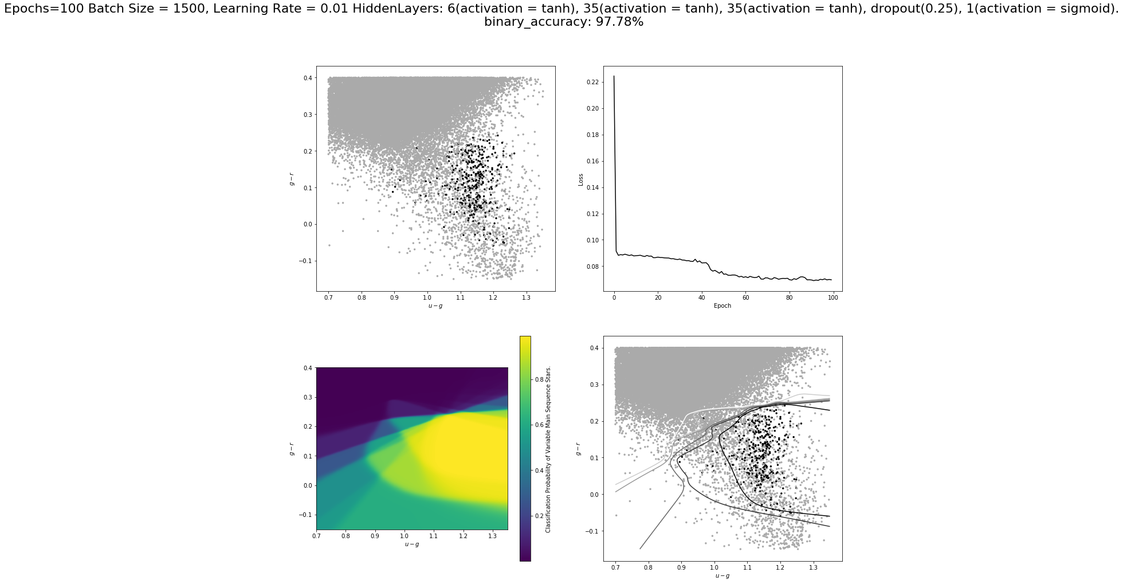
Hidden: 35 x 2, tanh
Hidden: 6, tanh
Out:
1, Sigmoid
Input: 2,3,4
Dropout(0.25)
Notes:
The final component was to add a dropout layer to the network that systematically cuts out 25% of the neurons in the final layer.
The resulting decision boundary is interesting here as in areas where there was no representation of the data it ascribed it 50:50 classification, im not sure if this is better than that shown in the previous slide but we felt like it was a more honest less bias representation of the data.
Quick!!!!::::::::
So in order to apply neural networks we used the tensor flow platform, after many different network designs we setted on a network of 3 hidden layers, the first consisting of 6 neurons and the other 2 of 35 neurons, we also encounted the problem of overfitting the data and this was remidded by including a drop out layer that systematically cuts out 25% of the neurons in the previous hidden layer.
The decision boundary here was particularly interesting as in areas where there was no representation of the data it ascribed it 50:50 classification, im not sure if this is better than that shown in the previous slide but we felt like it was a more honest less bias representation of the data.

Slide 11
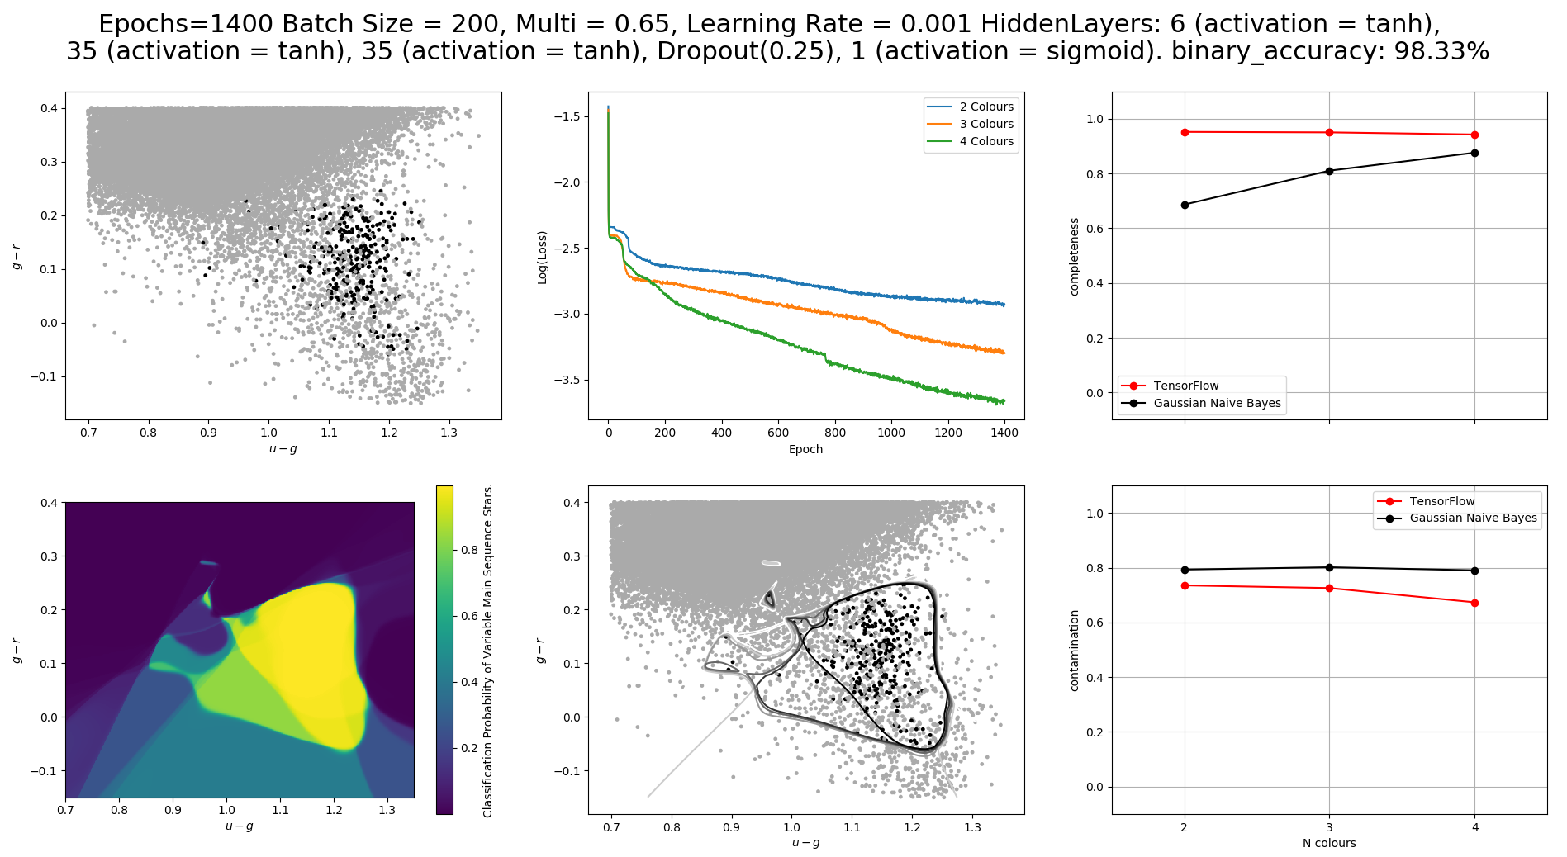
Notes:
So after various other tweaking of the network parameters such as learning rate, batchsize and the ratio of the artificial rebalancing of the data we are left with the following results.
On the right you can see that the neural network demonstrated better completeness and contamination than the traditional method, and this applied for all number of color features input into the network.

Slide 12
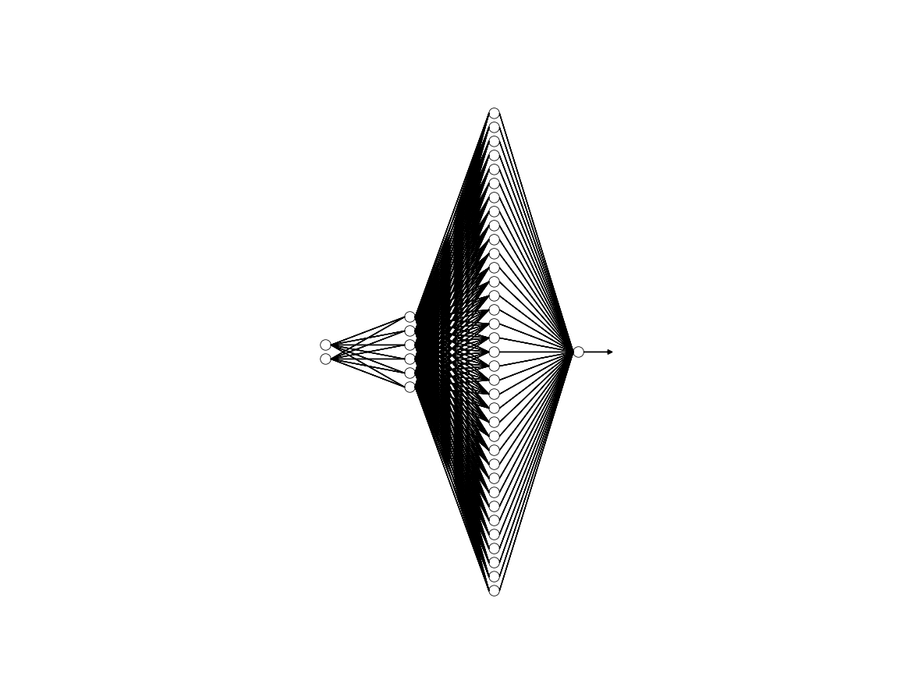
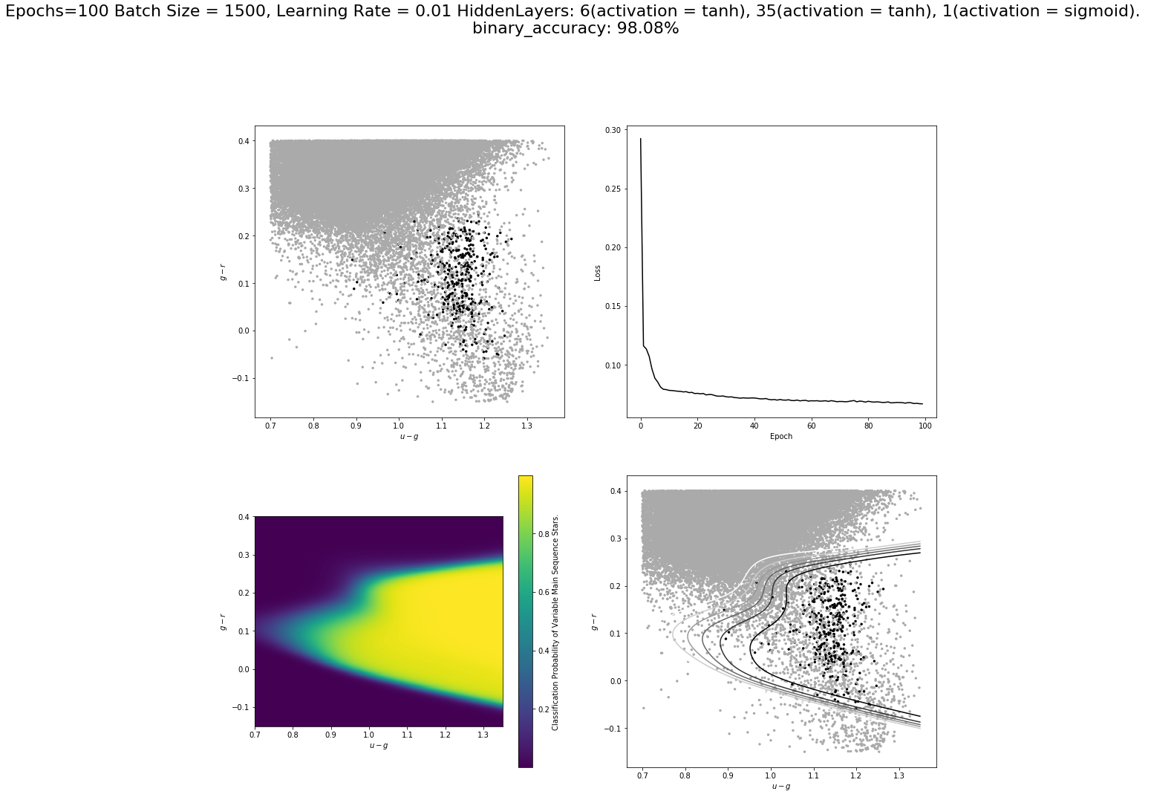
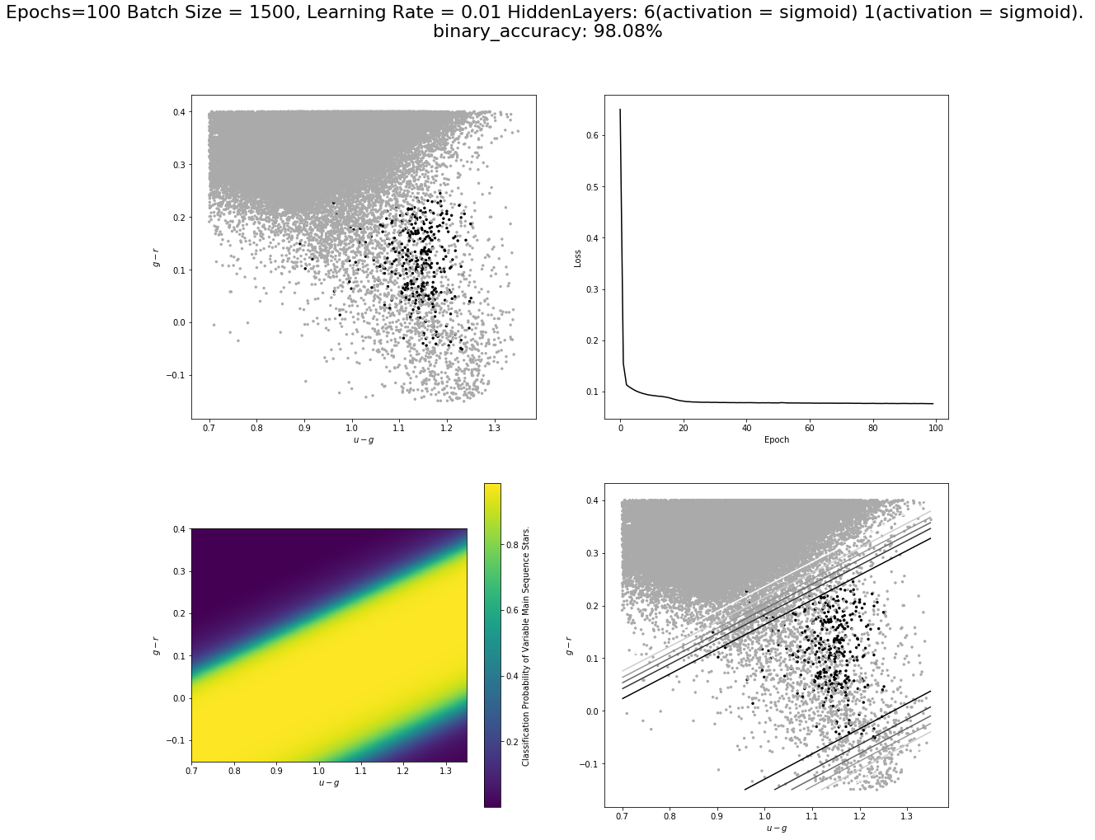
Hidden: 35, tanh
Hidden: 6, tanh
Out: 1, Sigmoid
Input: 2,3,4

Slide 13
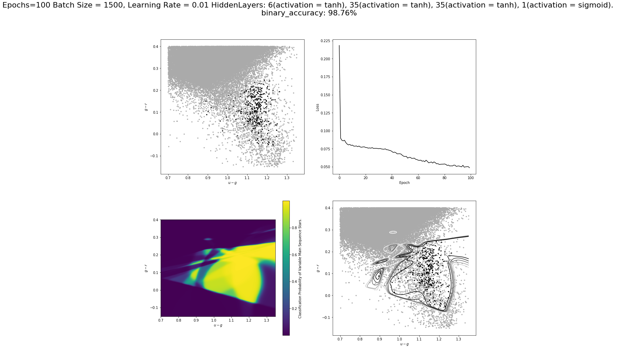

Slide 14
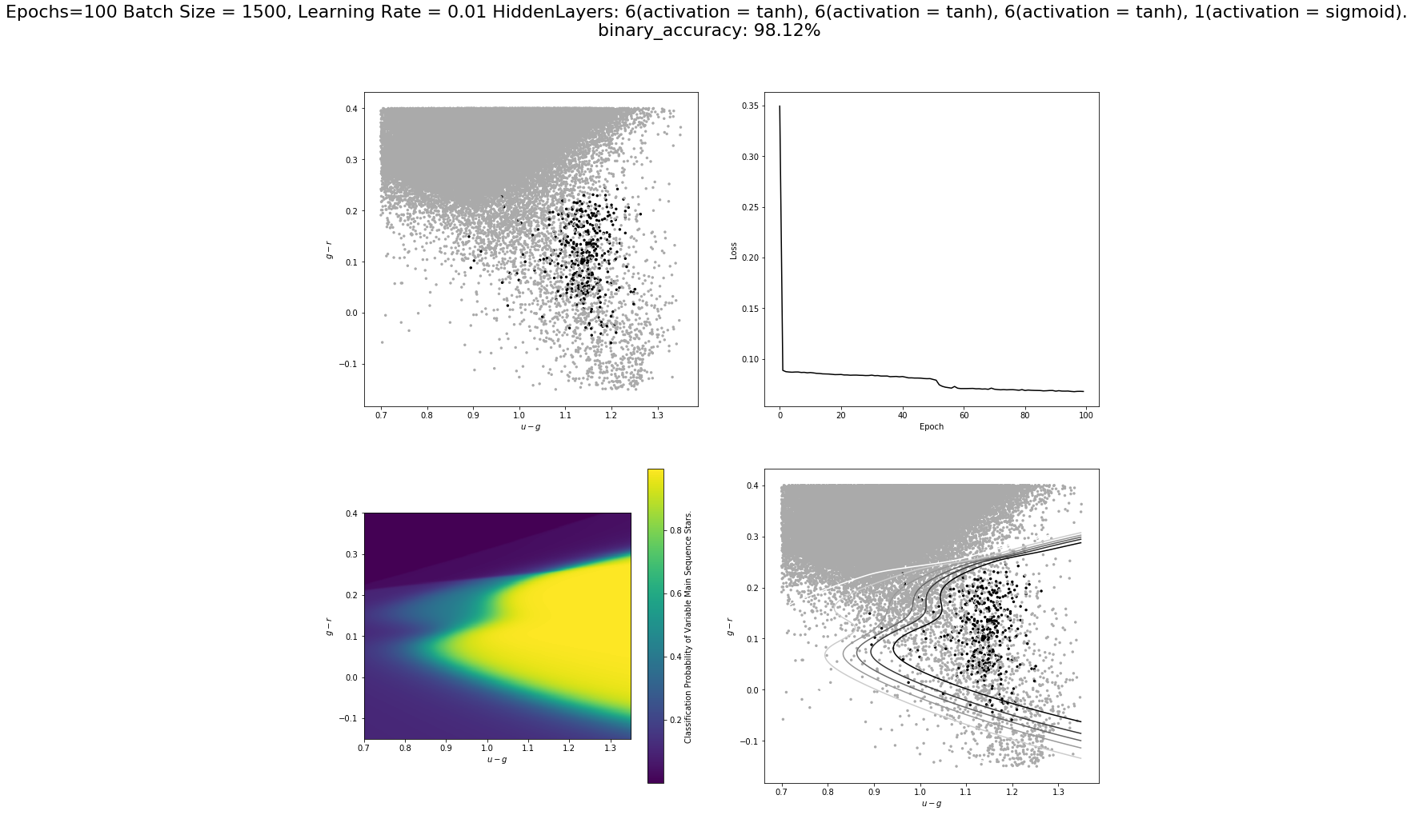

Slide 15
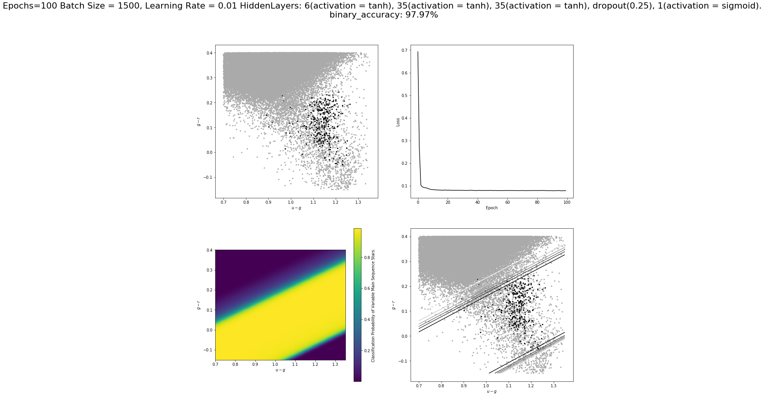
All sigmoid

